Slide 1
Big Data Analysis
of Census Income Dataset
Composed By: Section 0502-Team E
-Keya Mankar

Slide 2
Project Overview
Descriptive Analytics
Perform Exploratory Analysis of Census Income data with an aim to find statistical distribution of different socio-economic factors.
Predictive Analytics
Predict whether a person would earn more than 50k annually based on socio- economic factors such as education, age, race, etc.

Slide 3
Dataset Overview:
Source:https://archive.ics.uci.edu/ml/datasets/Census+Income
Number of records: 48,842
Total Number of Attributes: 15

Slide 4
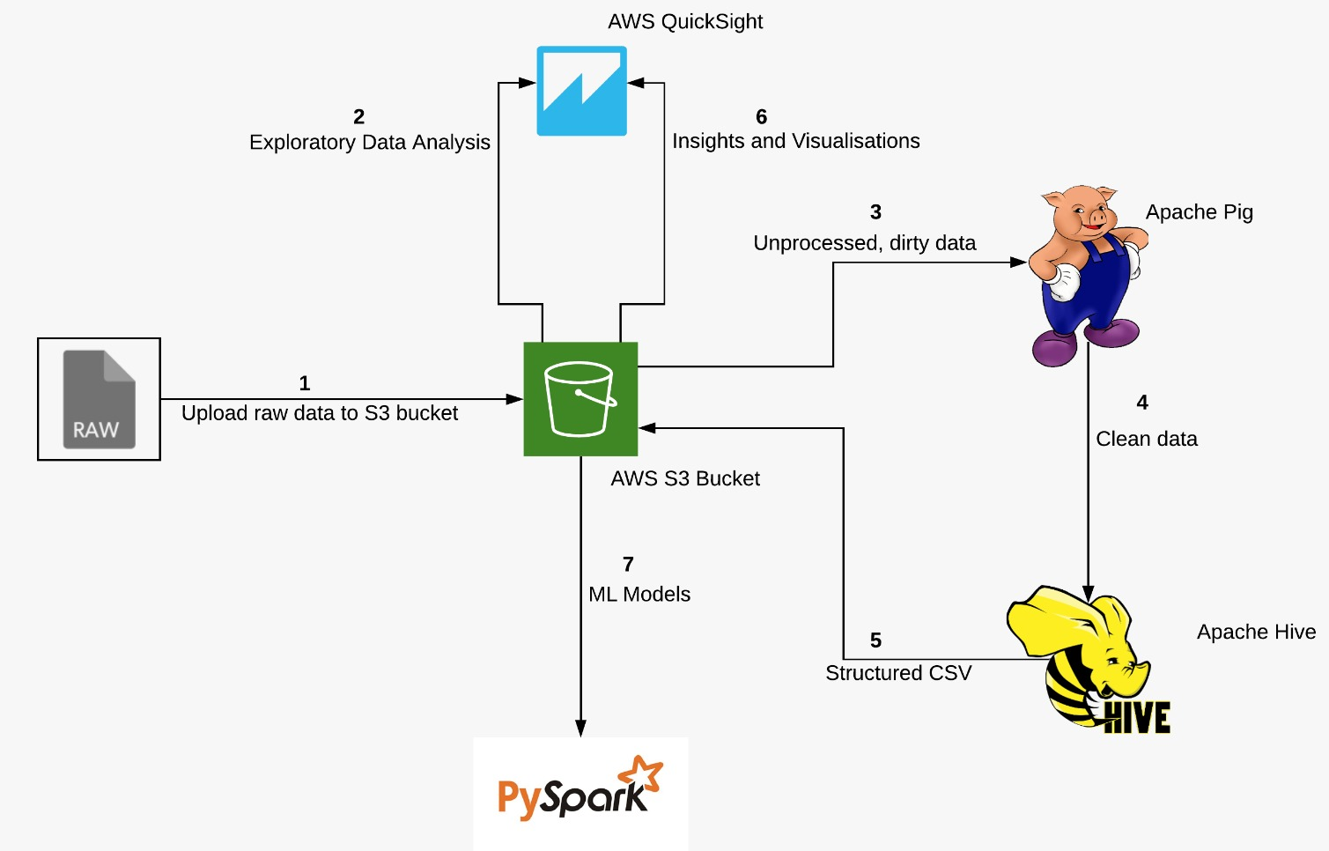
Workflow

Slide 5

Descriptive Data
Analysis

Slide 6
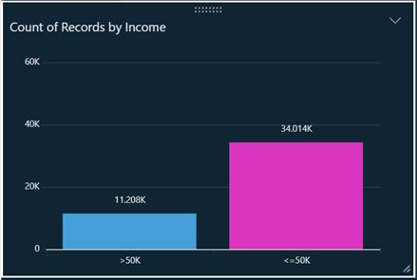
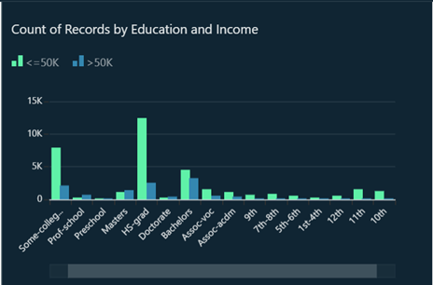
More number of people earn less than 50K. (Approximately 76% earn less than 50K)
Higher the education may provide higher earning.
Maximum people belong to HS still only 5.12% earn more than 50K where as for Bachelor’s 6.78% earn more than 50K

Slide 7



Slide 8
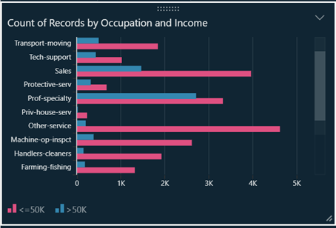
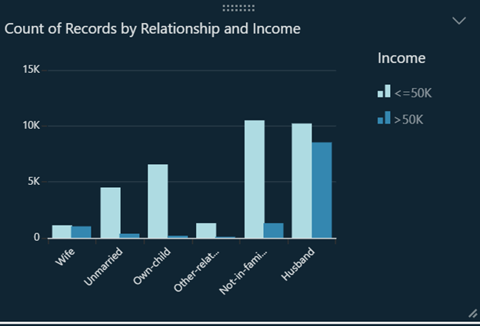
In every occupation, percentage of people earning less than 50k is more than people earning more than 50k
Husbands have the highest percent of earning more than 50K.
“Not-in-family” highest percent to earn less than 50K but their percent to earn more than 50K (2.61%) is same as “wife” (2.46%)

Slide 9

Predictive
Analytics

Slide 10
Feature Selection using Pyspark
Conducted feature selection using a series of iterations using Logistic Regression
Iteration 1: - Performed a Logistic Regression on all 14 independent variables and measured accuracy
- Eliminated the independent variables with least 3 coefficients values

Slide 11
Feature Selection using Pyspark
Iteration 2: - Performed Logistic Regression using 11 independent variables and measured accuracy
- Eliminated the independent variables with least 3 coefficient values
(Repeated the above steps till accuracy remained same or declined)
Short-listed 8 variables based on standardized coefficient values (Age, Workclass, Education, Marital Status, Relationship, Race, Sex & Hours_week)

Slide 12
Predictive Analysis using Pyspark
Performed 4 predictive algorithms to predict individuals with income over $50,000 .
Predictive algorithms used:
- Logistic Regression
- Random Forest
- Support Vector Machine
- Gradient Boosting

Slide 13
Predictive Analysis using Pyspark
(70-30 Validation Set Approach, Seed=1234)
.
Predictive Algorithms Used | Accuracy (%)
Logistic Regression | 87.49%
Random Forest | 85.54%
Support Vector Machine | 86.39%
Gradient Boosting | 87.89%

Slide 14
Business Value
Investment banking firms
Non-Profit Organizations
Marketing
Political Campaigning
Shaping Tax policies
Emergency Response
Notes:
Middle-age people with education level higher than that of a high school graduate are more likely to make investments and have returns on those investments ( as they have high Capital-gain)
Non-Profit
This insight is valuable for organizations trying to use a customer segmentation/ versioning strategy to target middle-age customers. ( How to target more educated people vs less educated people?)

Slide 15
Inferences
According to our data, in United States, education plays a key role in determining an individual’s income (directly proportional relationship)
Census data is valuable for various organizations in fields like finance, non-profit, government, technology etc.
In 2016, 70.06% of the population earned below 50K as compared to 76.07% in 1996

Slide 16
Appendix
Technical Paper Reference:
Data Analysis to the Income and Economic Hierarchy on Census Data
Google Drive Link of Project Code and Scripts:
Google Drive - Project Link
GitHub - Project Link

Slide 17
THANK YOU!
Any Questions?

